Slide 1
Smart Agriculture System Based On IOT
NAME: NIDHI SINGH
PROJECT ID: SPS_PRO_101
INTERNSHIP TITLE: Smart Agriculture system based on IoT - SB52113
YOUTUBE LINK :https://youtu.be/SbwSBw6qt9o

Slide 2
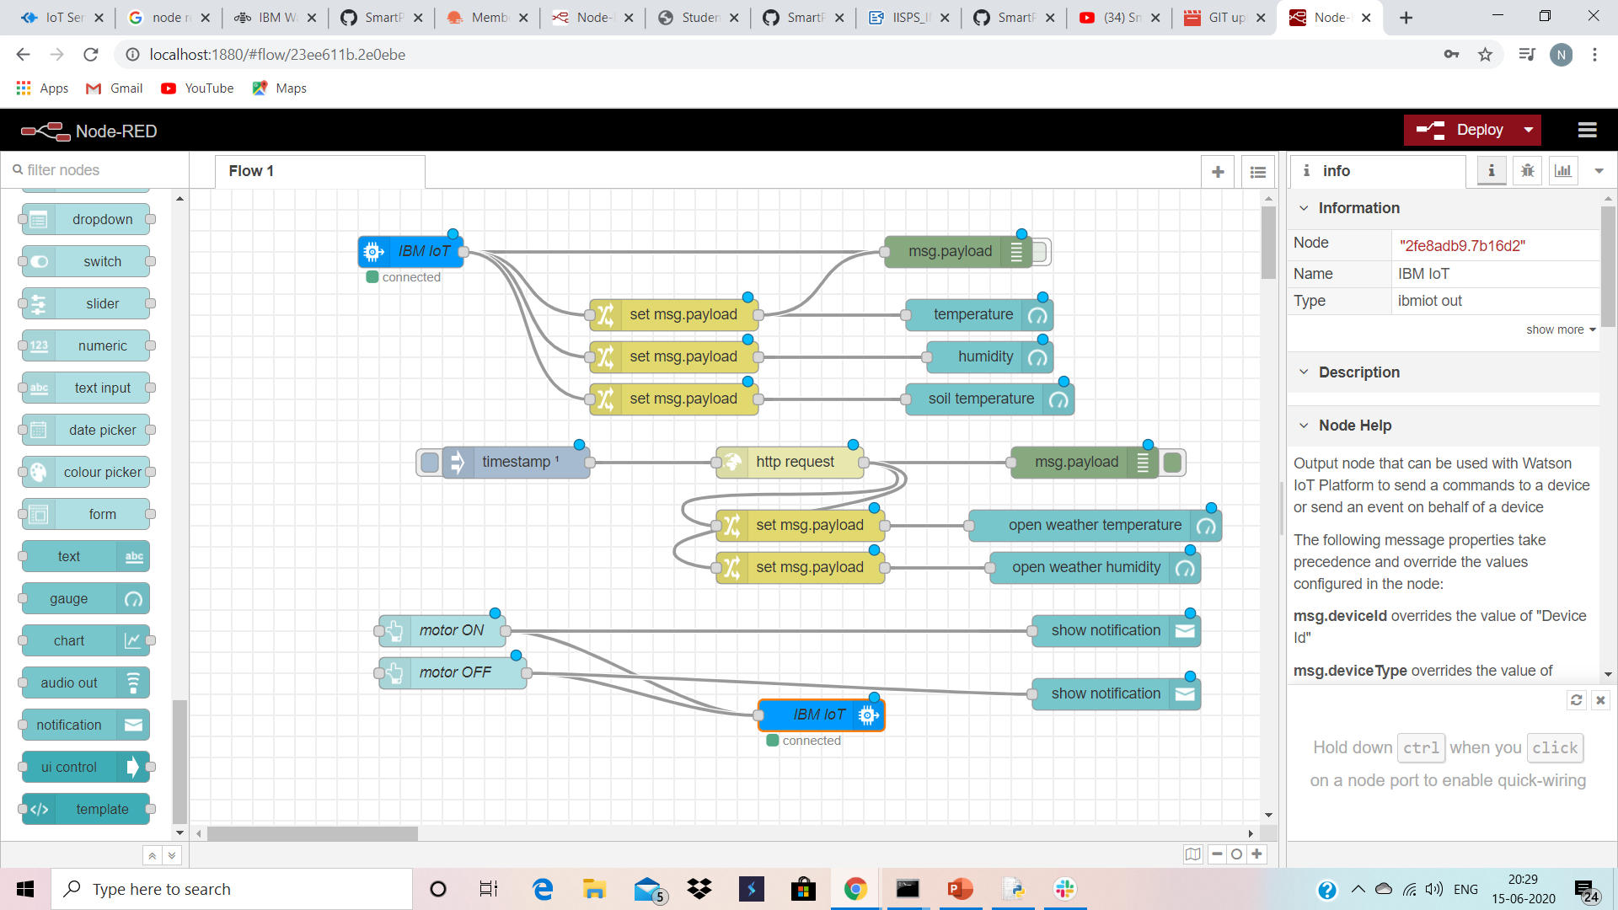
Block Diagram On Node-Red

Slide 3
PROJECT SCOPE
-THIS UI DEVELOPED FOR FARMERS WILL ENABLE THE TO MONITOR THE REAL TIME FIELD PARAMETERS LIKE TEMPERATURE,HUMIDITY,SOIL MOISTURE AND ACCORDINGLY CONTROL THE MOTOR TO IRRIGATE THEIR FIELDS.
THE FARMERS CAN IRRIGATE THEIR LANDS FROM ANYWHERE.
AS OUR COUNTRY IS AN AGRICULTURE BASED COUNTRY SO THIS UI SYSTEM WILL HELP MALLIONS OF FAMILIES TO OVERCOME THIS ISSUE.

Slide 4
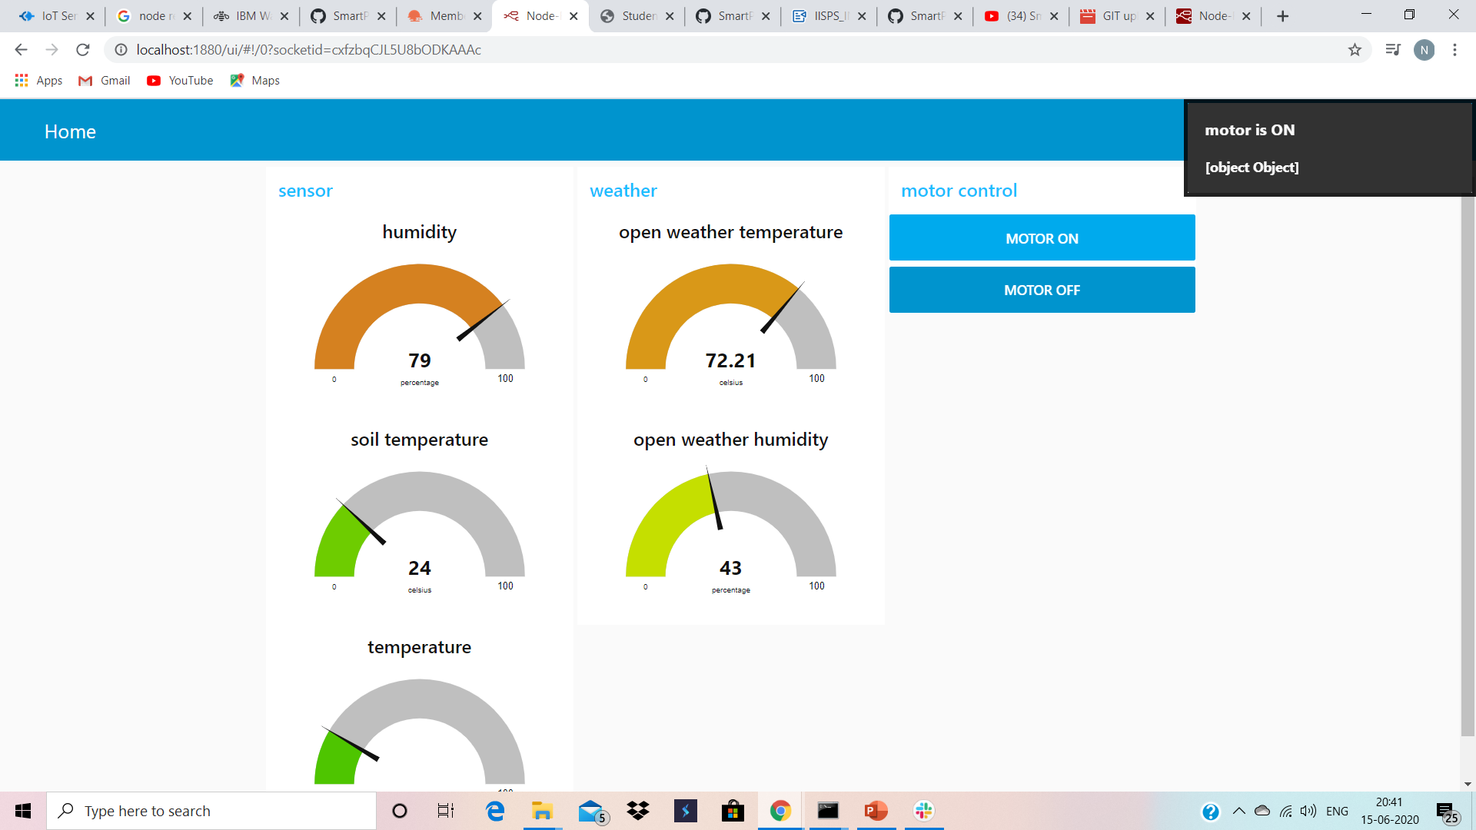
DEMONSTRATION OF THIS UI SYSTEM

Slide 5
THANKYOU

